Slide 1
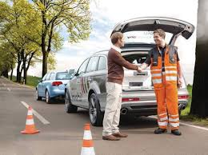
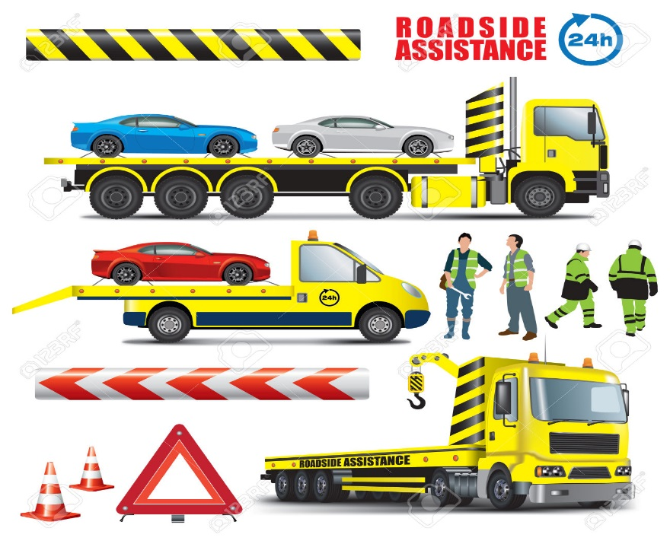
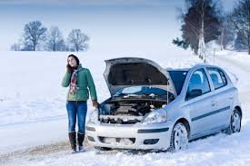
Predict Emergency Roadside Assistance Car Breakdown Call Volume

Slide 2
Data Set
Using the following data
Integrated historical data and public road side events
Data set from NJ DOT
http://www.state.nj.us/transportation/refdata/
Weather Data
http://www.wunderground.com/

Slide 3
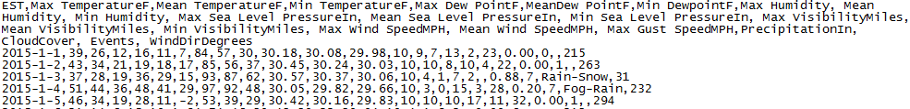
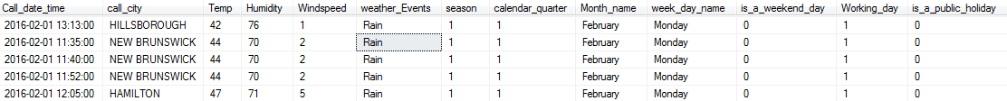
Data Processing and Cleanup
Historical Call volume data set
nn
Weather dataset
Final data set

Slide 4
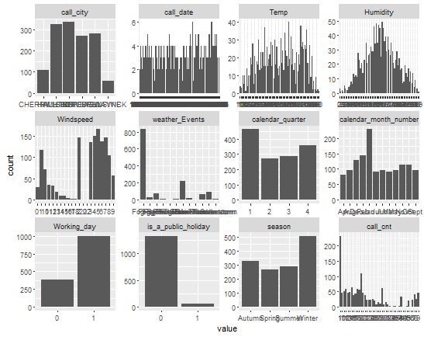
Univariate Variable distributions

Slide 5
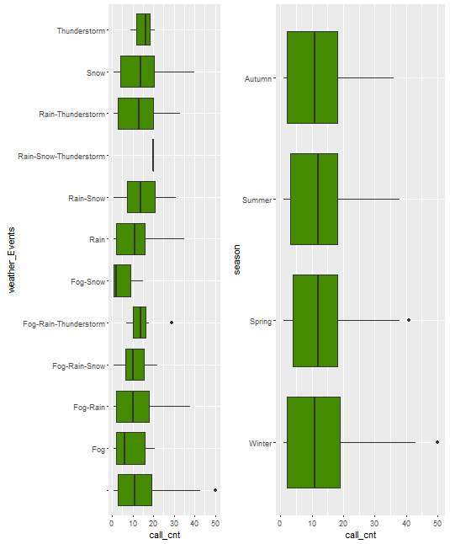
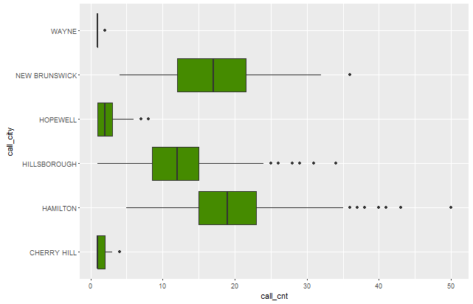
Data distributions

Slide 6
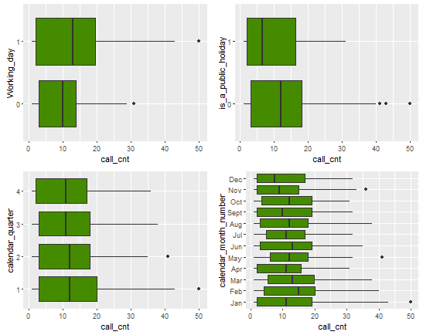
Data distribution of call Volume Vs calendar date

Slide 7
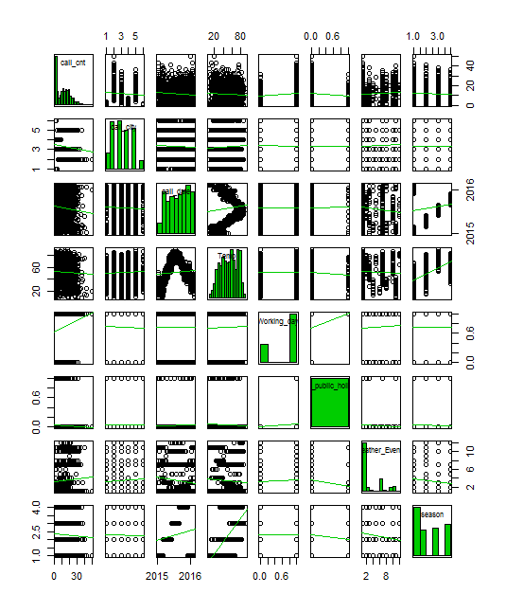
Scatter Plot Matrix

Slide 8
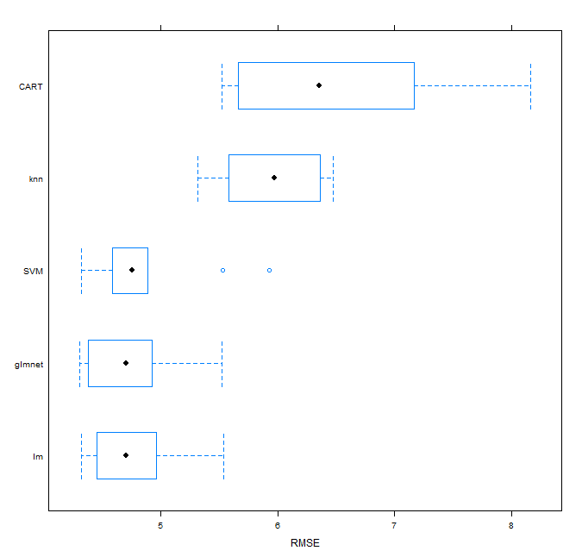
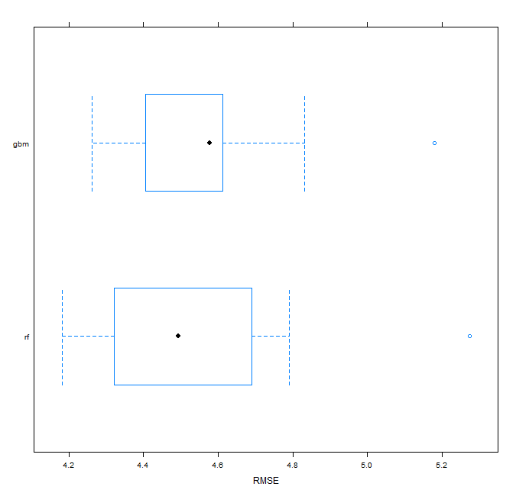
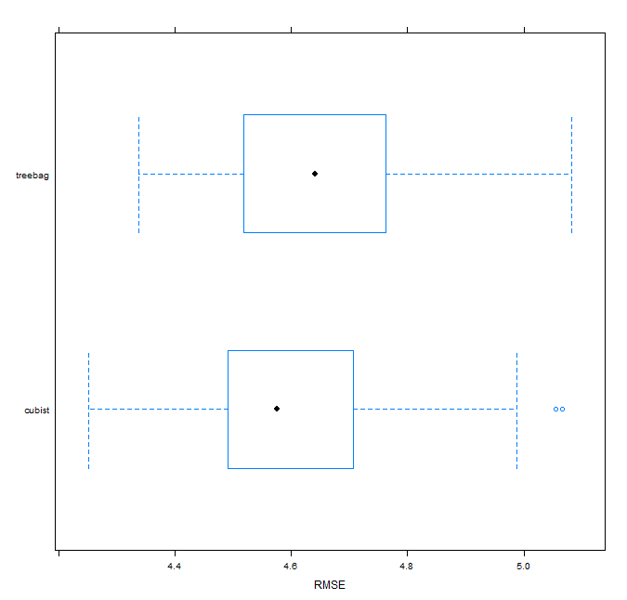
Model Training and Evaluate Algorithms
Algorithm Models | RMSE | Rsquared
glmnet | 4.73 | 0.72
CART | 6.48 | 0.47
SVM | 4.87 | 0.71
Linear regression (lm) | 4.74 | 0.72
K-Nearest Neighbour (knn) | 5.95 | 0.56
Algorithm
 | RMSE | Rsquared
gradiant boosting(gbm) | 4.57 | 0.75
random forest(rf) | 4.54 | 0.75
Algorithm
 | RMSE | Rsquared
cubist | 4.61 | 0.73
treebag | 4.66 | 0.73

Slide 9
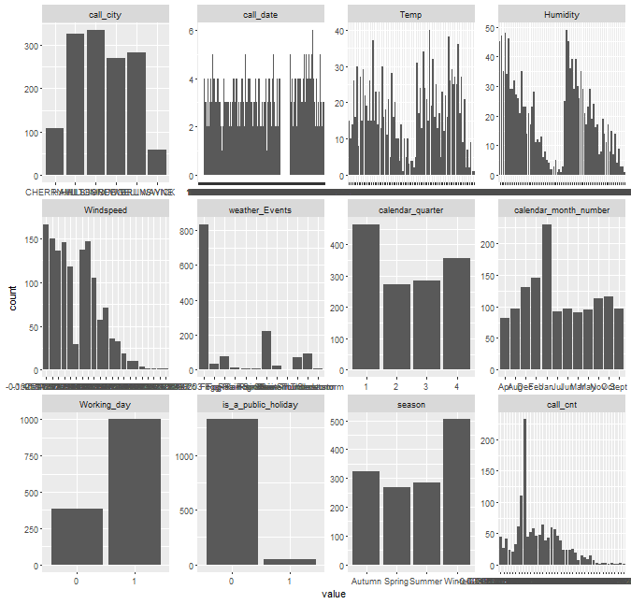
After applying transformation on variables
Algorithm Models | RMSE | Rsquared
glmnet | 4.73 | 0.72
CART | 6.48 | 0.47
SVM | 4.87 | 0.71
Linear regression (lm) | 4.74 | 0.72
K-Nearest Neighbour (knn) | 5.95 | 0.56
Algorithm
 | RMSE | Rsquared
gradiant boosting(gbm) | 4.57 | 0.75
random forest(rf) | 4.54 | 0.75
Algorithm
 | RMSE | Rsquared
cubist | 4.61 | 0.73
treebag | 4.66 | 0.73

Slide 10
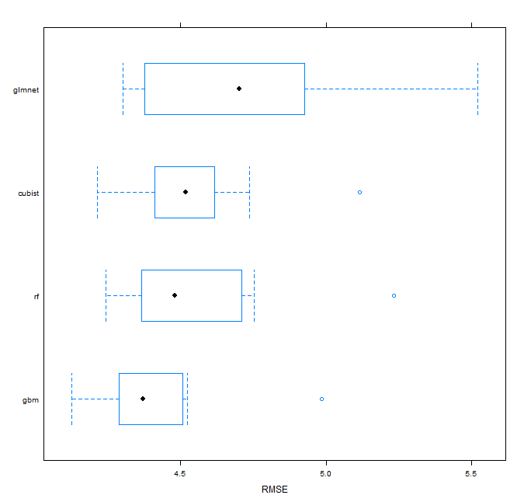
After Further tuning the parameters
After tuning parameters
Model | RMSE | Rsquared
gradient boosting(gbm) | 4.42 | 0.76
random forest(rf) | 4.54 | 0.74
cubist | 4.55 | 0.74
glmnet | 4.73 | 0.72

Slide 11
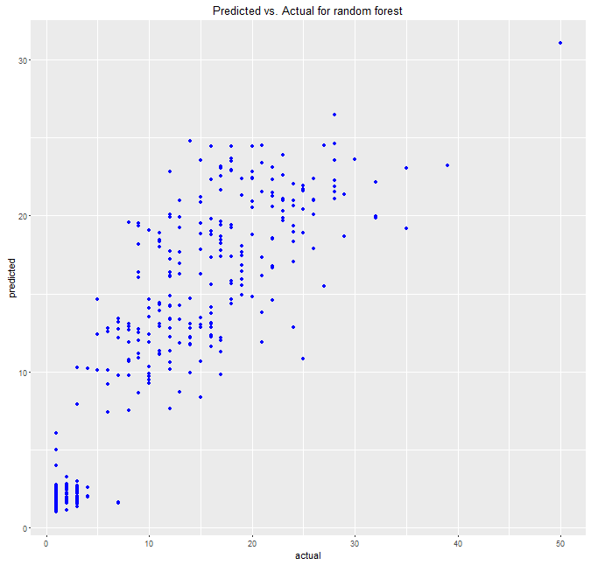
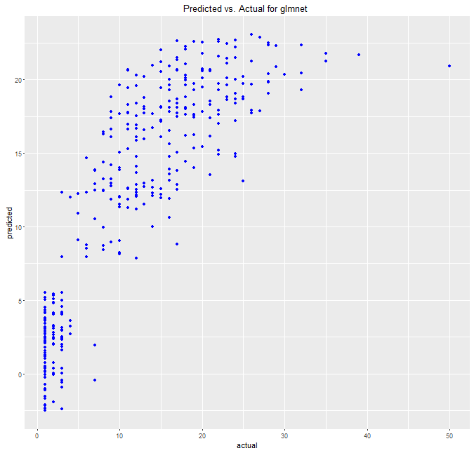
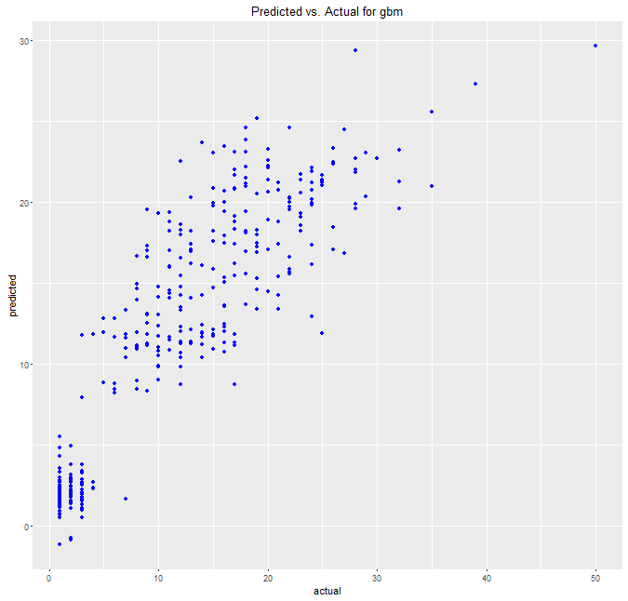
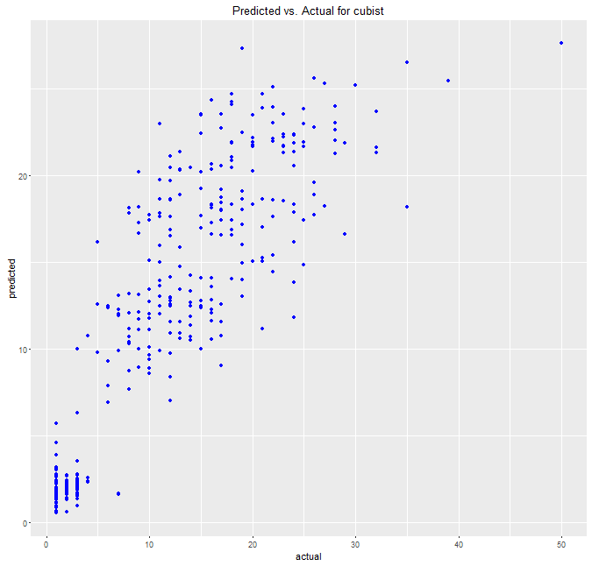
Predict and evaluate accuracy and finalize the model
Algorithm | Trained Model |  | After Predicting with test data
Model | RMSE | Rsquared | RMSE | Rsquared
gradiant boosting(gbm) | 4.42 | 0.76 | 7.9 | 0.77
random forest(rf) | 4.54 | 0.74 | 4.48 | 0.75
cubist | 4.55 | 0.74 | 4.53 | 0.75
glmnet | 4.73 | 0.72 | 4.74 | 0.72

Slide 12
Client usage and benefits
How would Client benefit by predicting the Call Volume.
Be prepared for inclement weather conditions and respond faster to customer for assistance
Reduce the wait time and response time
CSAT scores can be improved and customer acquisition can be improved.
“Expect the best. Plan for the worst” – customer loyalty

Slide 13
Next Steps
Add additional variables to improve the model prediction
1). Traffic Volume
2). Construction Data
3). Handle the outliers and tag the missing data equally
Apply further transformation techniques and improve the Accuracy of the model so that we can predict the call volume.

